Slide 1
Lecture 1: Review of 109A Preview of 109B

Slide 2
Outline
Who
What have we learned in 109a?
What is covered in 109b
Course Logistics

Slide 3
Outline
Who
What have we learned in 109a?
What is covered in 109b
Course Logistics

Slide 4
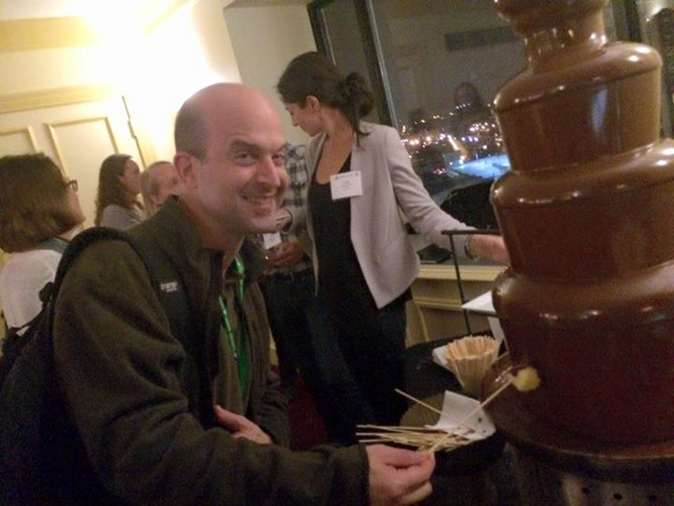
Who: Instructors
Mark Glickman: Senior Lecturer in Statistics

Slide 5
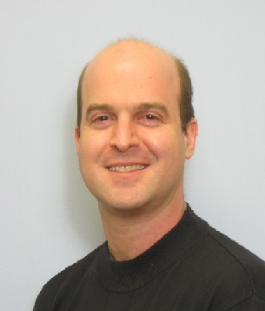
Who: Instructors (cont)
About Mark Glickman:
BA in Statistics from Princeton; PhD in Statistics from Harvard
Chess master, inventor of Glicko and Glicko-2 rating systems for head-to-head competition, ratings committee chair of US Chess
Former Editor-in-Chief of the Journal of Quantitative Analysis in Sports (2015-2017)
Director of the Harvard Sports Analytics Laboratory
Senior Statistician at the Center for Healthcare Organization and Implementation Research, a Veterans Administration Center of Innovation
Fellow of the American Statistical Association
Board of Directors member of the American Statistical Association (ASA); Co-Chair of the Committee on Data Science of the ASA.

Slide 6
Who: Instructors (cont)
Pavlos Protopapas: Scientific Director of the Institute for Applied Computational Science (IACS)

Slide 7
About Pavlos Protopapas
BSc in Physics, Imperial College, PhD in Theoretical Physics, UPENN
Teaches CS109 and the IACS Capstone Course
Active member of the astrostatistics community. Research at the intersection of astronomy, machine learning and statistics
Member of Alerce, an intelligent broker for online annotating celestial objects from streaming data
Loves classical music, hiking and anything adventurous

Slide 8
Who: Lab Instructors
Rahul Dave
Lecturer at IACS. PhD in cosmology, teaches AM207. He loves climbing, hiking and he is also known as the human Google.
Lab: AWS and scaling up your calculations (Lab 4)
Eleni Kaxiras
Eleni has been the CS109a/b Head TF for 3 years. She is also a staff member at SEAS, advising courses in the use of computation for teaching and learning. She holds a Bachelor’s in Physics and she produces her own olive oil.
Labs: NN optimization (Lab 3) and CNNs (Lab5)
Head TF

Slide 9
Who: Lab Instructors
Will Claybaugh
IACS Master's student, former social network analyst at Booz Allen Hamilton. Former fencer, built and flew on a cluster of 18 weather balloons,
Labs: Setting up environments (Lab 1), Smoothing/GAM (Lab2), Clusteting Lab 7), Bayes 2 (Lab 9)
Srivatsan Srinivasan
Labs: RNNs (Lab 6) and GANS (Lab 11)

Slide 10
Who: Lab Instructors
Vivek Hv
Lab 10 (Bayes 1), Lab 10 (Autoencoders and variational autoencoders)

Slide 11
Who: Advanced Section Leaders
Javier Zazo
Optimization, Dropout, Advanced CNNs, NN transfer learning,
Srivatsan Srinivasan
Deep RL, Variational Inference
Marios Matthaiakis
Vivek Hv

Slide 12
Who: Teaching Fellows
Sol Girouard
Brandon Walker
Principal data scientist for LexisNexis Risk Solutions Healthcare Analytics Group. He has TF’ed CS109a twice.
Yujiao Chen

Slide 13
Who: Teaching Fellows
Rashmi Banthia
Evan Mackay
Curtis Hsu
Alex Lin
Anirudh (Ani) Suresh

Slide 14
Outline
Who
What have we learned in 109a?
What is covered in 109b
Course Logistics

Slide 15
109A
Scraping, skLearn, numpy, Pandas, matplotlib
Visualization best practices
Linear, multiple and polynomial regression
Model Selection and regularization
Logistic Regression, multiple and polynomial.
kNN classification
Decision Trees, RF, Boosting, Stacking
SVM
AB testing and experimental design

Slide 16
Outline
Who
What have we learned in 109a?
What is covered in 109b
Course Logistics

Slide 17
Topics
The semester is divided into 2 parts.
▶ Part 1: Smoothing, Unsupervised Learning and Bayesian inference all in python
▶ Modules: Incorporates everything from 109a and 109b into modules.

Slide 18
Course topics covered by Glickman
Regression splines, smoothers, additive and generalized additive models
Unsupervised learning and cluster analysis
Introduction to Bayesian methods
Hierarchical modeling
Latent Dirichlet Allocation (topic modeling)

Slide 19
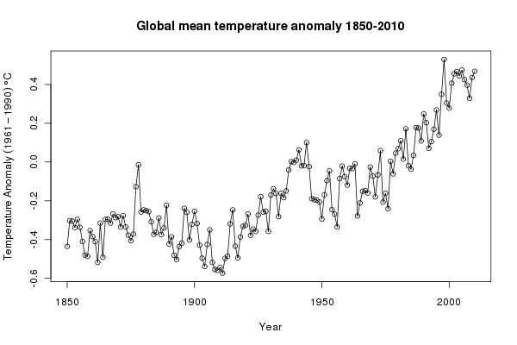
Course topics covered by Glickman (cont)
Smoothers and GAMs: (raw data)

Slide 20
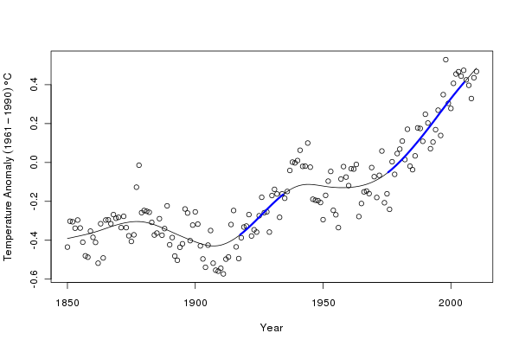
Course topics covered by Glickman (cont)
Smoothers and GAMs: (smoothed fit)

Slide 21
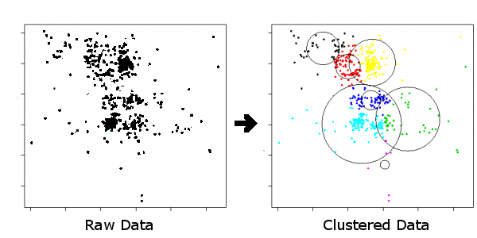
Course topics covered by Glickman (cont)
Cluster analysis:

Slide 22
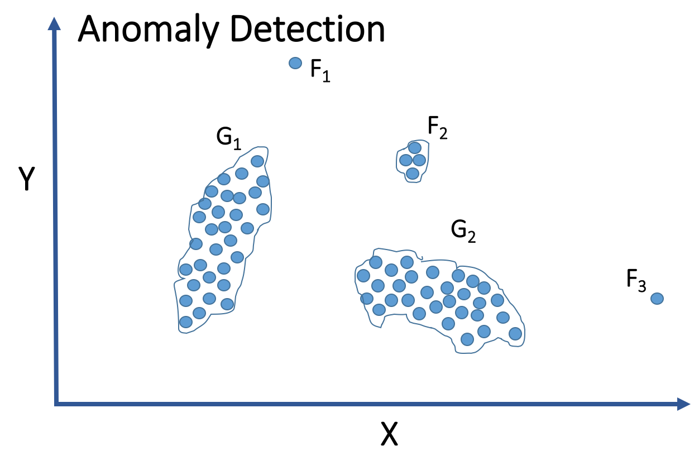
Course topics covered by Glickman (cont)
Example use of cluster analysis:

Slide 23

Course topics covered by Glickman (cont)
Bayesian statistics:

Slide 24
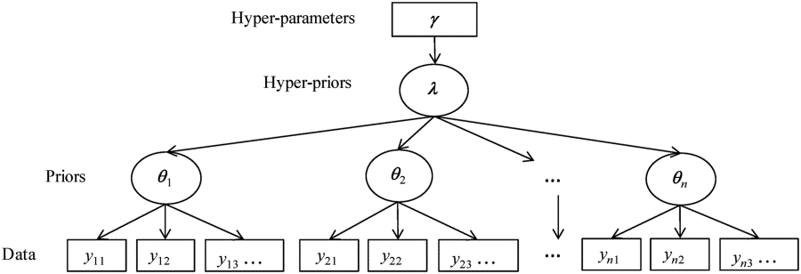
Course topics covered by Glickman (cont)
Bayesian statistics: Hierarchical modeling

Slide 25
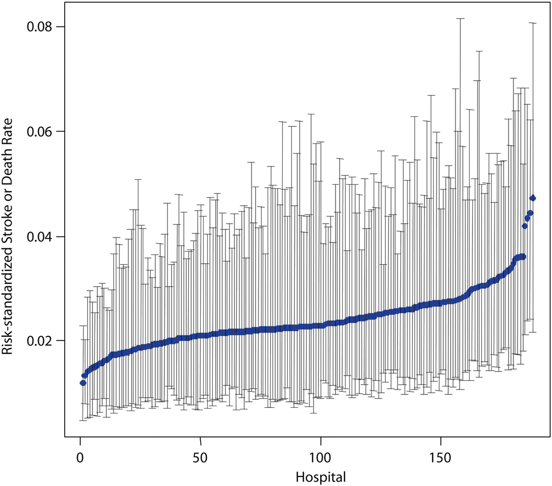
Course topics covered by Glickman (cont)
Bayesian statistics: Hierarchical modeling
Hospital Variation in Carotid Stenting Outcomes

Slide 26
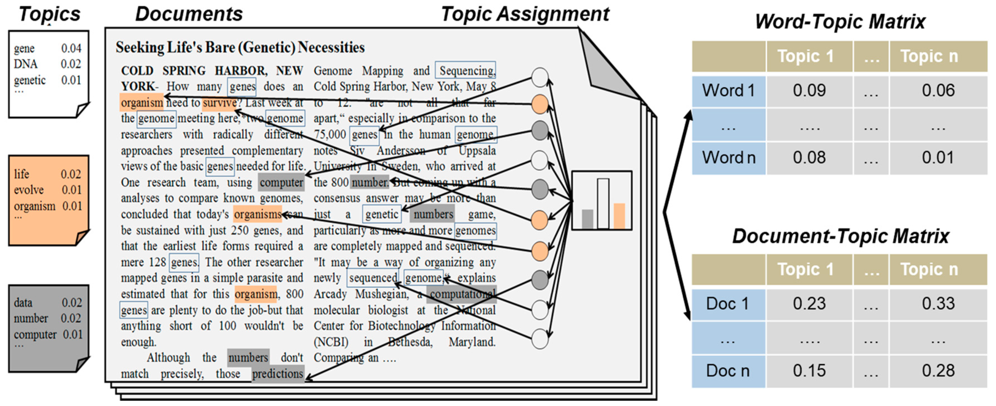
Course topics covered by Glickman (cont)
Bayesian statistics: Latent Dirichlet Allocation

Slide 27
Course topics covered by Pavlos
Deep Neural Network
Review from 109a: Neural Net Basics & Math, Deep Feed Forward, Regularization
Optimization
CNNs
RNNs
Autoencoders
Variational Autoencoders
GANs
Deep reinforcement learning

Slide 28
Course topics covered by Pavlos (cont)
RNN classification and summarization
Math Smart: I'm not too far into the book yet, but already I think it's great. The voice that the text is written in is so supportive, which may sound silly, but for people like me who are intimidated by math, this encouraging voice really helps. Things are explained well and the book makes me feel that I really can learn this stuff. False 91327 91326 Actual Sentiment: Negative Predicted Sentiment: Negative

Slide 29
Course topics covered by Pavlos (cont)
RNN sequence modeling

Slide 30

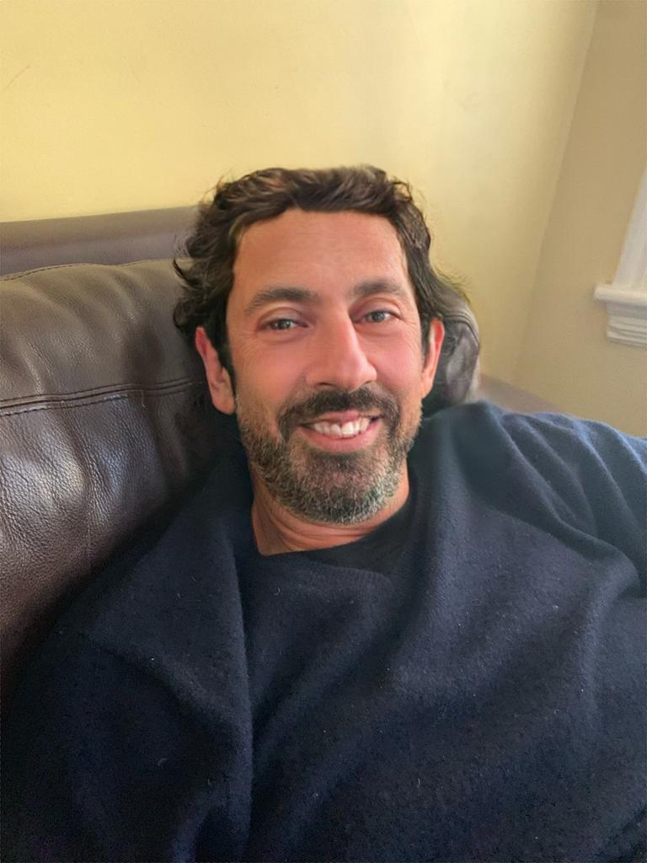
Course topics covered by Pavlos (cont)
Autoencoders and Variational Autoencoders (blending)

Slide 31
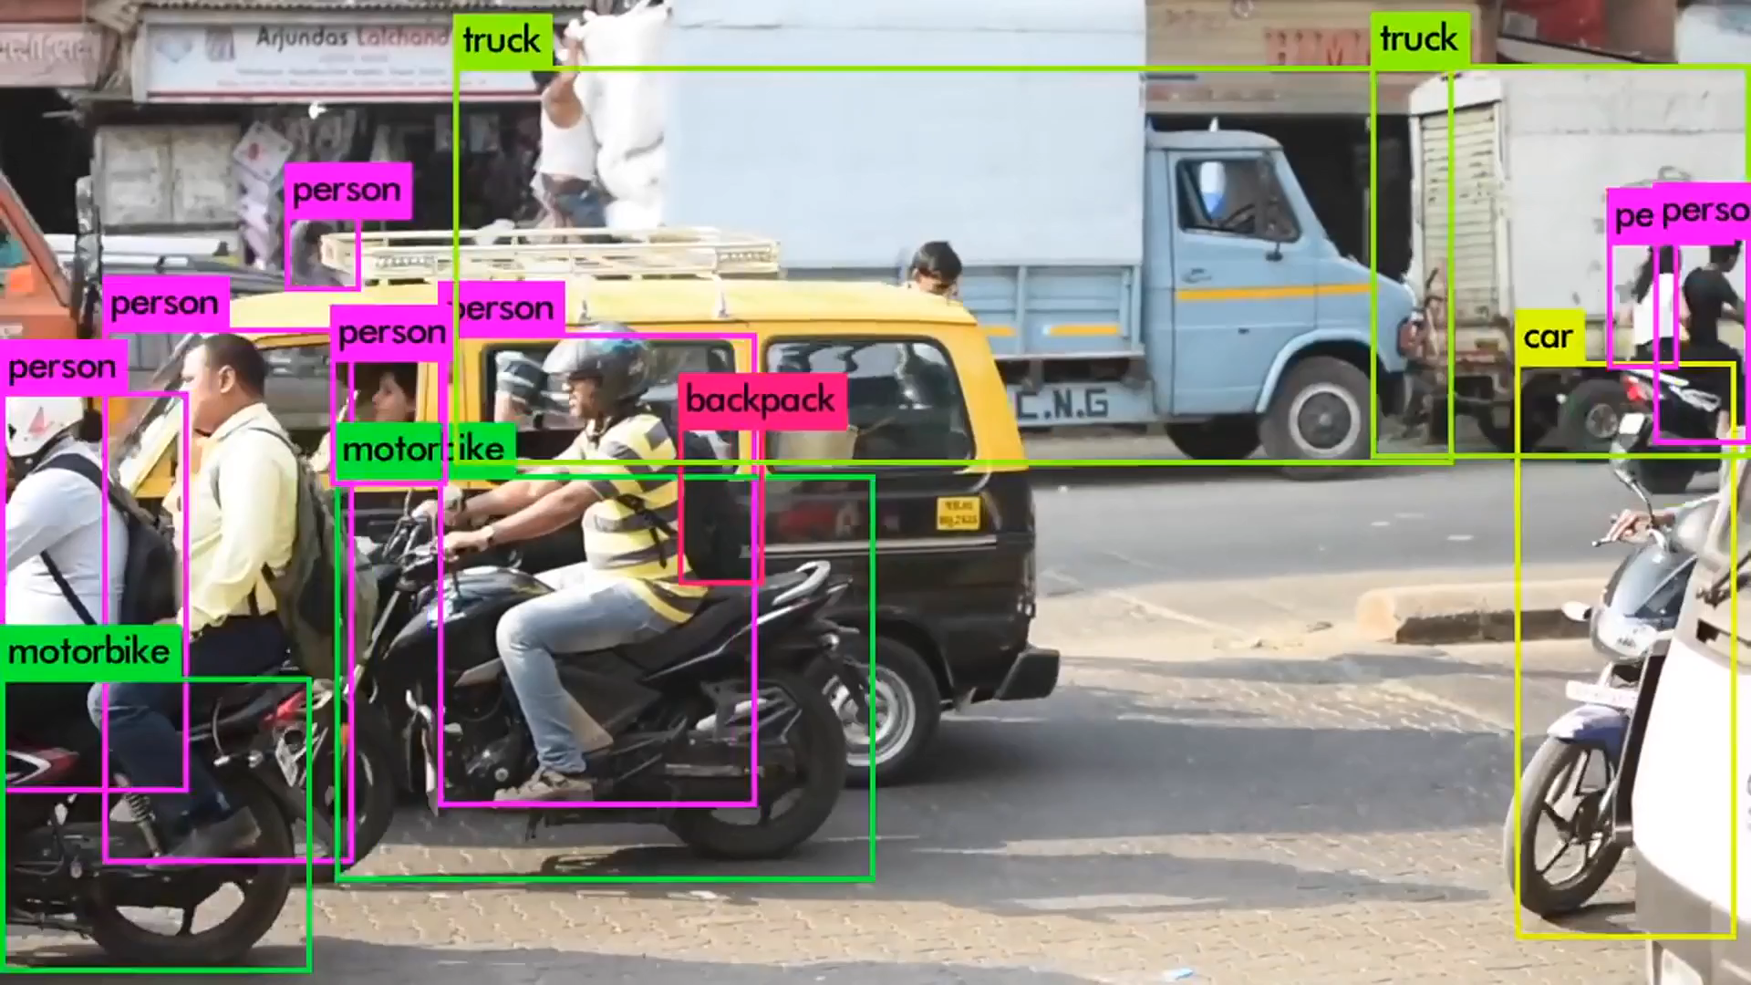
Course topics covered by Pavlos (cont)
You Only Look Once (YOLO) - 2016

Slide 32
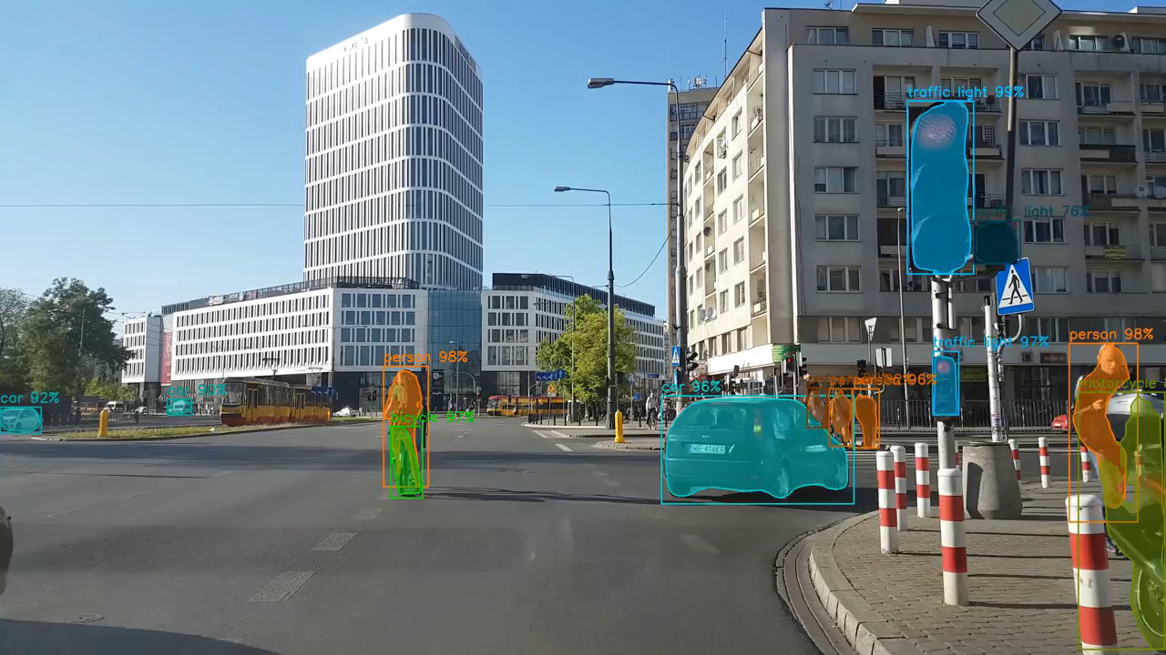
Course topics covered by Pavlos (cont)
Mask- RCNN - 2017

Slide 33
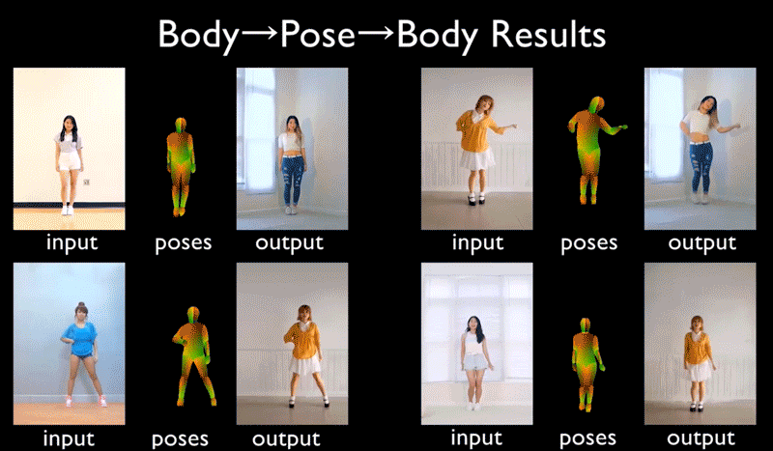
Course topics covered by Pavlos (cont)
NVIDIA Video to Video Synthesis - 2018

Slide 34
Other Topics
▶ Scalability issues: AWS
▶ Databases: SQL

Slide 35
Projects/Modules
During the final four (4) weeks of the course, students will be divided in break-out thematic sections where they will study topics such as medicine, law, astronomy, e-commerce, and government. Each section will include lectures by faculty, experts on the field, followed by project work also led by that faculty. You will get to present your projects in the SEAS Design Fair at the end of the semester.
Matthew Holman. Director of the Minor Planet Center
Goerg xxx:
ASFA
ADFaf

Slide 36
Outline
Who
What have we learned in 109a?
What is covered in 109b
Course Logistics

Slide 37
Outline
Who
What have we learned in 109a?
What is covered in 109b
Course Logistics
Lectures, Labs and Office Hours
AC209
Homeworks
Content Organization
Grades

Slide 38
Outline
Who
What have we learned in 109a?
What is covered in 109b
Course Logistics
Lectures, Labs and Office Hours
AC209
Homeworks
Content Organization
Grades

Slide 39
Lectures, Labs and Office Hours
Lectures: Mondays and Wednesdays 1:30-2:45pm @ Maxwell-Dworkin G-115.
During lecture will cover the material which you will need to complete the homework. Attending lectures is required - quizzes at the end of each lecture (drop 40% of them) .
Lecture notes and associated notebooks will be posted before lecture on Canvas and GitHub (Pavlos Lectures only)
Lectures will be video tapes (and live streamed for DCE students) and posted approximately in 24 hours on Canvas.
Note: For DCE students the quizzes are optional

Slide 40
Lectures, Labs and Office Hours (cont)
Labs: Thursdays 4:30-6:00pm @ Pierce 301
Labs are meant to help you understand the lecture materials better via examples.
Labs will also be video taped (and live streamed for DCE students) and posted approximately in 24 hours on Canvas

Slide 41
Lectures, Labs and Office Hours (cont)
Instructors Office Hours:
▶ Mark: By appointment
▶ Pavlos: Monday 3:00-4:00pm, MD G108
TF Office Hours: Check canvas in the next day or so

Slide 42
Outline
Who
What have we learned in 109a?
What is covered in 109b
Course Logistics
Lectures, Labs and Office Hours
AC209
Homeworks
Content Organization
Grades

Slide 43
AC 209 Students
Students enrolled for the AC 209B course have the following extra requirements:
Attend A-Sections
Complete extra questions in homework (HW3-HW8)
Expand the scope of the final project (modules)

Slide 44
AC 209 Students (cont)
Advance Sections Topics:
Optimization/EMD
Dropout
ConvNets: LeNet, AlexNet, VGG-15, ResNet and Inception (HW)
LSTN, GRU in NLP (HW)
Neural style transfer learning (HW)
Deep RL (HW)
Variational Inference (HW)
GANS (HW)

Slide 45
Outline
Who
What have we learned in 109a?
What is covered in 109b
Course Logistics
Lectures, Labs and Office Hours
AC209
Homeworks
Content Organization
Grades

Slide 46
Homeworks
See schedule on canvas for released dates and due dates (http://bitly.com/2FWLM0v)
Homework 0 (Due Feb 6 11:59pm) Must submit
Homework 1 on smoothing
Homework 2 on FF NN and various optimizations
Homework 3 on CNNs
Homework 4 on RNNs
Homework 5 on Clustering and Autoencoders (individual)
Homework 6 on LDA and Bayes
Homework 7 on VAE+GANS (individual)

Slide 47
Homeworks (cont)
You are encouraged but not required to submit in pairs. Instructions on how to submit in pairs are on canvas.
If you work with someone else but not submitting in pair you should indicate who you have worked with.
All assignments will be posted on Tues. at 11:59pm and will be due Wed. at 11.59pm - one or few weeks later (see schedule for details).
You only need to submit .ipynb (no need to submit pdf)

Slide 48
Homeworks (cont)
Grading: The homework provides an opportunity to learn advanced data science skills and to bolster your understanding of the material. See the homework as an opportunity to learn, and not to earn points. The homework will be graded to reflect this objective.
WE WILL BE PROVIDING LENGTHY FEEDBACK AND DETAILS HOW GRADING IS DONE (different from 109a)

Slide 49
Homeworks (cont)
Late Policy: No homework assignments will be accepted for credit after the deadline. If you have a verifiable medical condition or other special circumstances that interfere with your coursework please let us know as soon as possible by sending an email to the Helpline.

Slide 50
Homeworks (cont)
Late Policy: No homework assignments will be accepted for credit after the deadline. If you have a verifiable medical condition or other special circumstances that interfere with your coursework please let us know as soon as possible by sending an email to the Helpline.

Slide 51
Homeworks (cont)
Regrades: Our graders and instructors make every effort in grading accurately and in giving you a lot of feedback.
If you discover that your answer to a homework problem was correct but it was marked as incorrect, send an email to the Helpline with a description of the error. Please do not submit regrade requests based on what you perceive is overly harsh grading.
The points we take off are based on a grading rubric that is being applied uniformly to all assignments.
If you decide to send a regrade request, send an email to the Helpline with subject line "Regrade HW1: Grader=johnsmith" within 48 hours of the grade release.

Slide 52
Content Organization
Github: https://github.com/Harvard-IACS/2019-CS109B
▶ Lab files and solutions
▶ Advanced Section materials
▶ Lectures (Pavlos’ lectures only)
Assignments and Mark’s lectures will only be posted on Canvas.

Slide 53
Grades
Paired-option Homeworks: 45% (5 homework for which you have the option to work in pairs)
Individual Homeworks: 25% (2 homework which you must complete individually, HW5 and HW7)
Quizzes: 10% (you may drop 40% of the quizzes)
Project: 20%

Slide 54
Academic Integrity
Ethical behavior is an important trait of a Data Scientist, from ethically handling data to attribution of code and work of others. Thus, in CS109 we give a strong emphasis to Academic Honesty.
As a student your best guidelines are to be reasonable and fair. We encourage teamwork for problem sets, but you should not split the homework and you should work on all the problems together.
Please be responsible and when in doubt ask either Pavlos, Mark, Eleni or Sol.

Slide 55
Auditing
Auditors are welcomed!
If you would like to audit the class, please send an email to the Helpline indicating who you are and why you want to audit the class. You need a HUID to be included to Canvas.
The only stipulation is that you don't plan to ask the teaching staff for help, attend office hours, etc., as these resources are intended for registered students.

Slide 56

Recommended Textbooks
ISLR: An Introduction to Statistical Learning, by James, Witten, Hastie, Tibshirani (Springer: New York, 2013)
DL: Deep Learning (http://www.deeplearningbook.org/) by
Goodfellow, Bengio and Courville.

Slide 57
Accommodations for students with disabilities
Students needing academic adjustments or accommodations because of a documented disability must present their Faculty Letter from the Accessible Education Office (AEO) and speak with the professor by the end of the second week of the term.
Failure to do so may result in the Course Head's inability to respond in a timely manner. All discussions will remain confidential.

Slide 58
Diversity and Inclusion
If you have a name and/or set of pronouns that differ from those that appear in your official Harvard records, please let us know!
If you feel like your performance in the class is being impacted by your experiences outside of class, please don’t hesitate to come and talk with us. If you prefer to speak with someone outside of the course, you may find helpful resources at the Harvard Office of Diversity and Inclusion.
We (like many people) are still in the process of learning about diverse perspectives and identities. If something was said in class (by anyone) that made you feel uncomfortable, please talk to us about it.
See our diversity and inclusion statement on canvas

Slide 59

Looking forward to a fun and productive semester!

